Slide 1
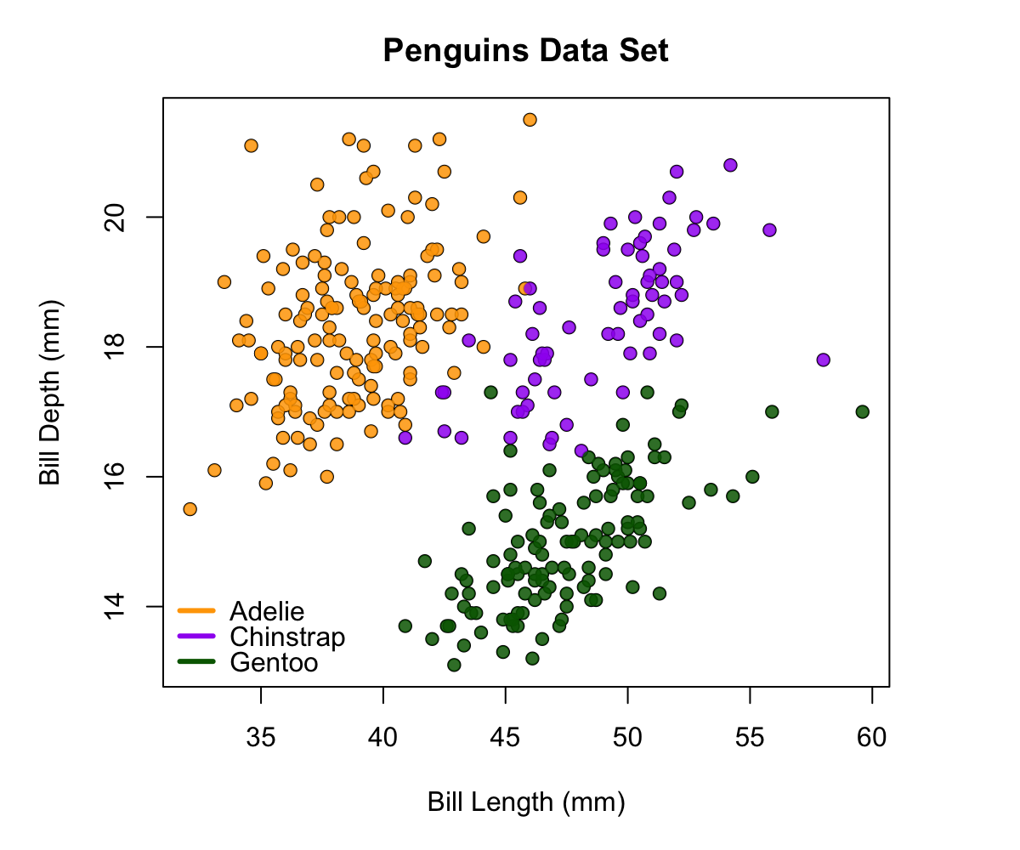
Multiple regression
Consider multiple factors that affect a response
Is the relationship the same for all species?
Just like 2-factor ANOVA.
Factor 1: Bill length
Factor 2: Species
Main effects
Factor 1: Does bill length influence bill depth on average across species?
Factor 2: Does the average bill depth differ among species?
Interaction
Does the effect of bill length (factor 1) depend on species (factor 2)?

Slide 2
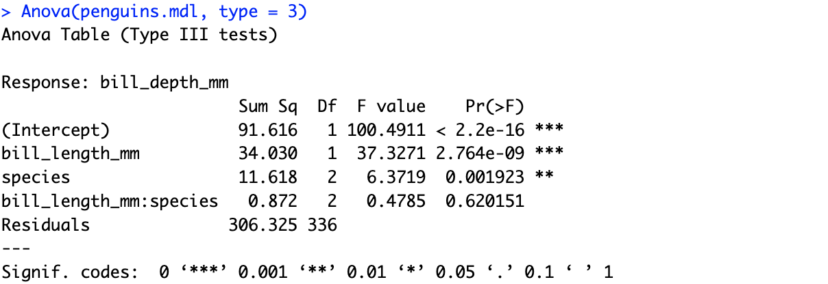
Step 1. Test interaction
Write the model to contain main and interactive effects
lm(bill_depth_mm ~ bill_length_mm*species, data = penguins)
Test for interactions by running a Type III Anova.
No evidence of an interaction between factors
If we remove it, we have more power to estimate main effects

Slide 3
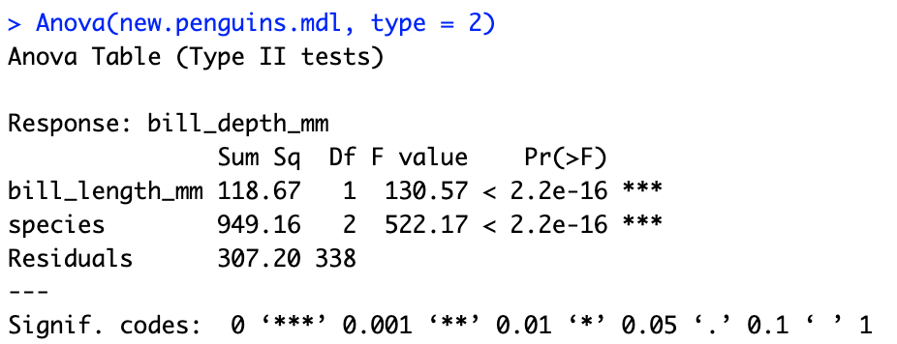
Step 2. Simplify model
Write the model with only main effects
lm(bill_depth_mm ~ bill_length_mm + species, data = penguins)
Look for evidence from ANOVA table for main effects.
Strong evidence for significant effects of bill length and species on bill depth

Slide 4
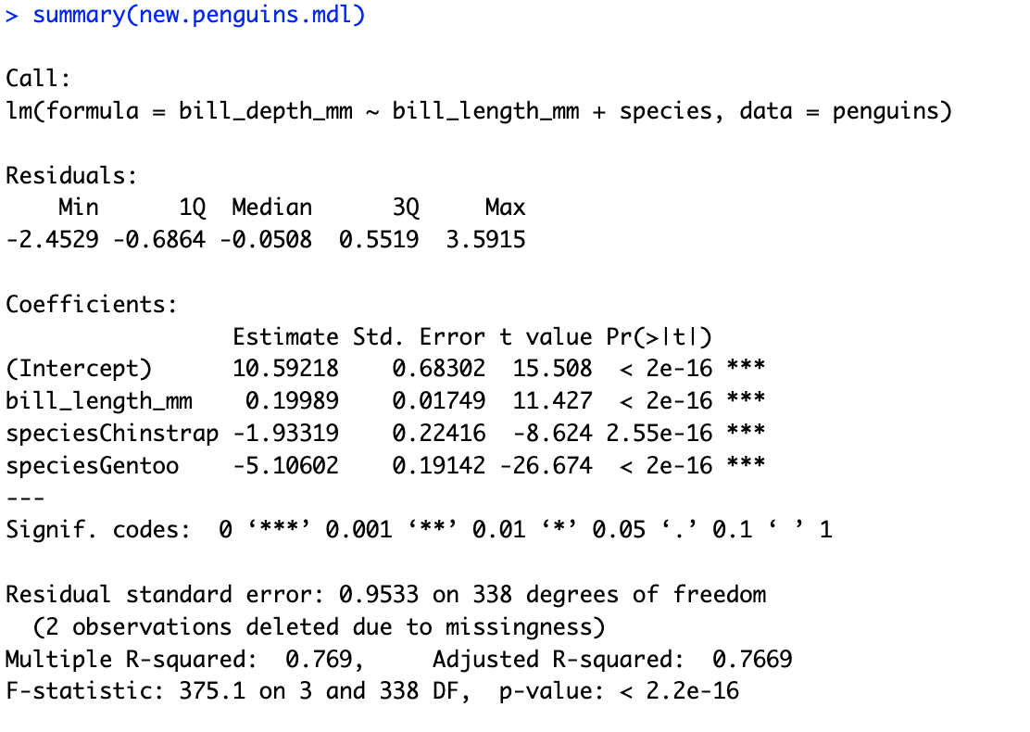
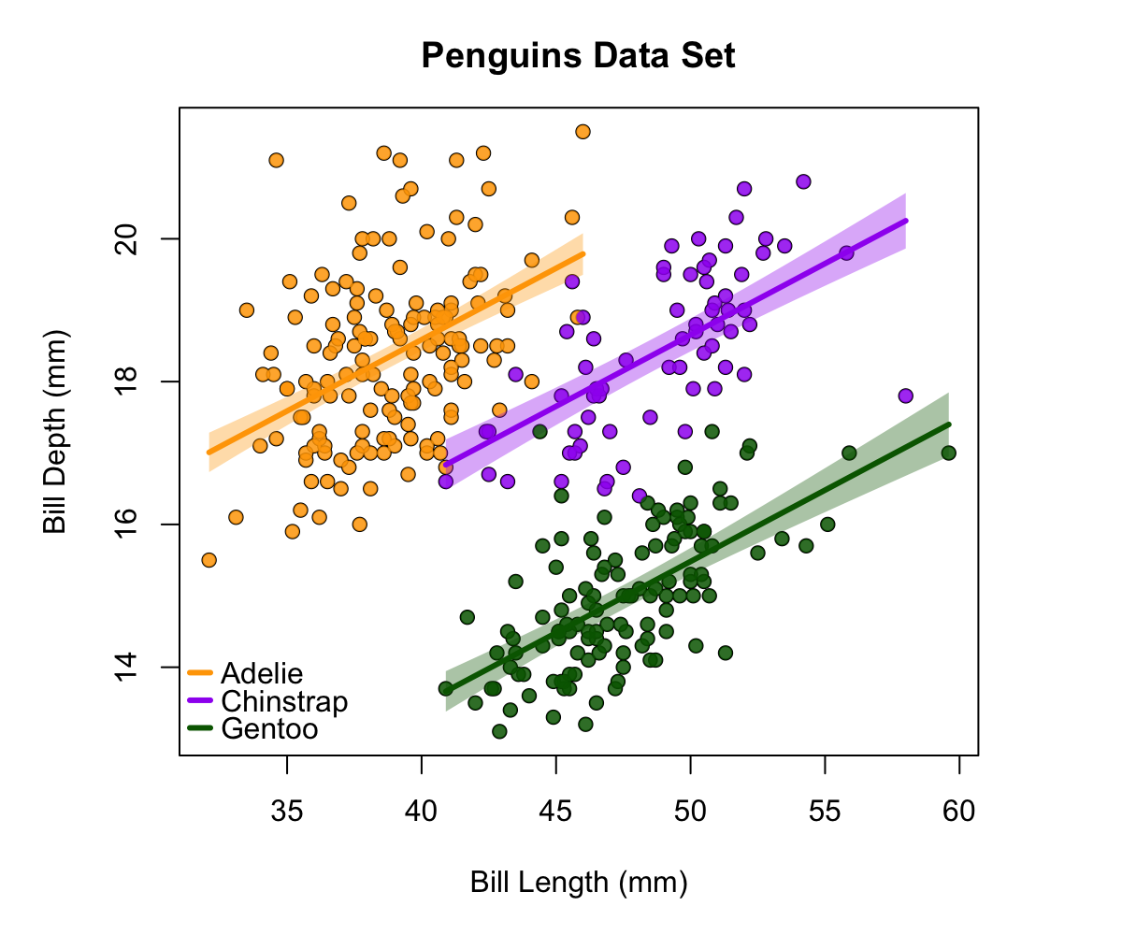
Step 3. Interpret Parameter Estimates
This can be tricky.
For categorical variables, R sets the first categorical variable as the baseline. What comes first? Species are arranged alphabetically.
(Intercept) Estimate = Intercept for Adelie

Slide 5
Step 3. Interpret Parameter Estimates
Common Slope

Slide 6
Step 3. Interpret Parameter Estimates
Common Slope

Slide 7
Step 3. Interpret Parameter Estimates
How much intercept differs between chinstrap and adelie

Slide 8
Step 3. Interpret Parameter Estimates
How much intercept differs between gentoo and adelie

Slide 9
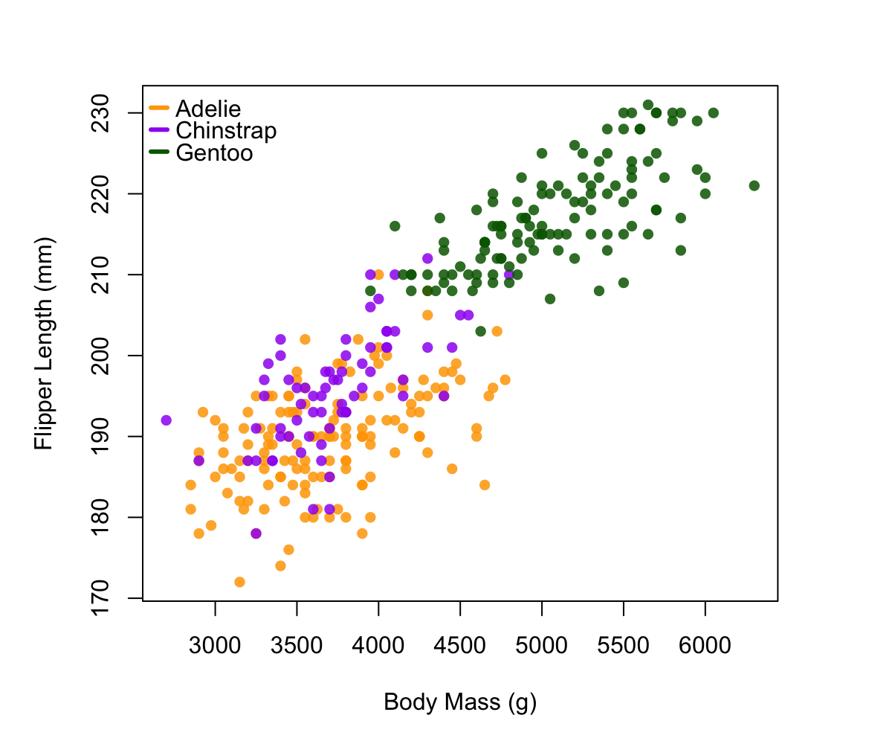
Body Size Relationships
Question: Do some species have proportionately larger flippers as they grow?
This is a question about interactive effects.
Gentoos have largest flippers.
Adelie have the smallest flippers.
But whose flippers get bigger faster with body size?
This is a question about differences in slopes between species (an interaction!).

Slide 10
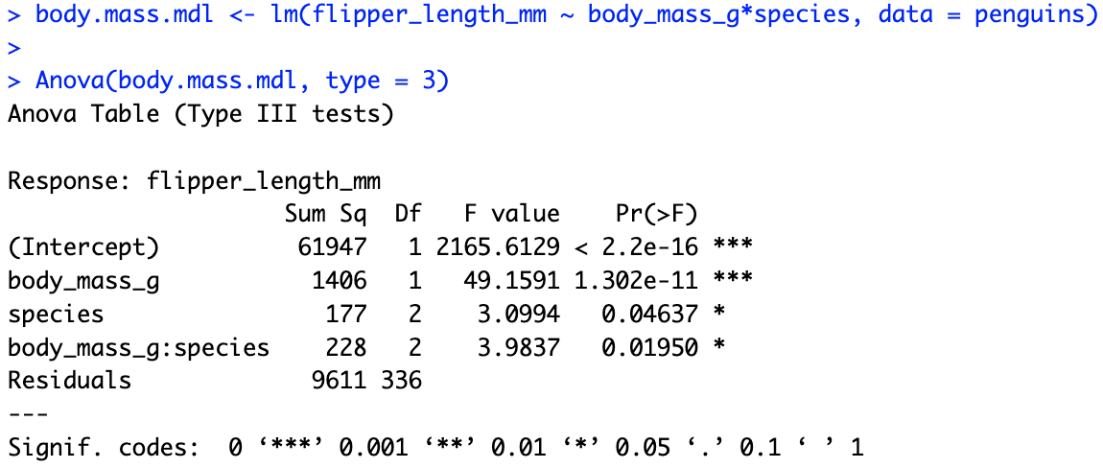

Slide 11
Looks like evidence for:
an interaction (i.e., different slopes)
main effect of species (species differ in flipper length) and
main effect of body mass (flipper length changes with body mass)

Slide 12
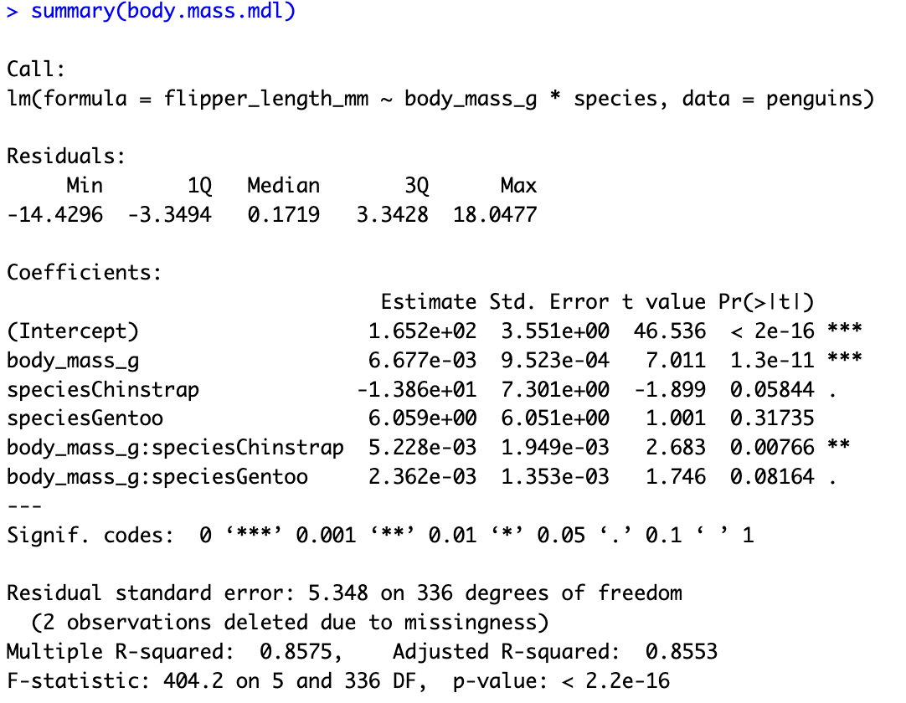
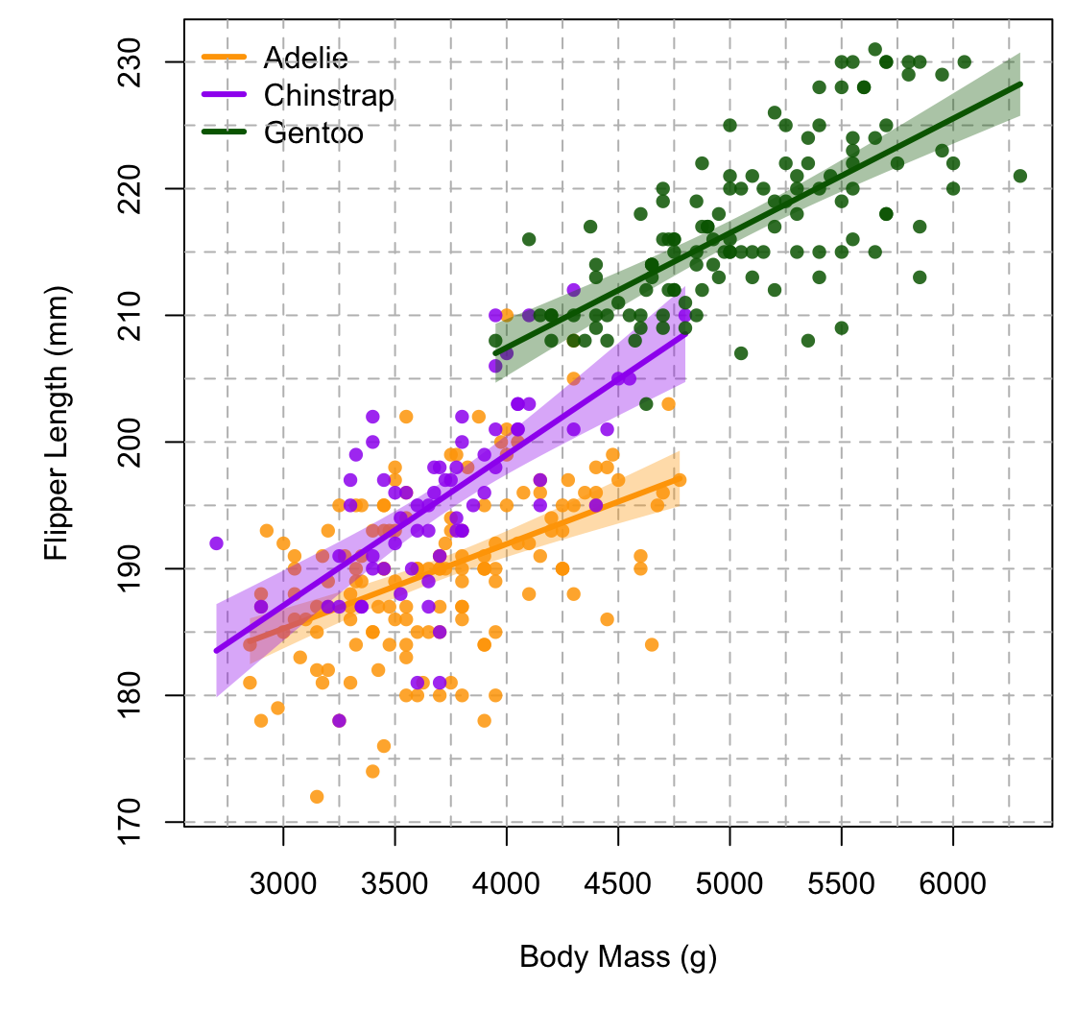
What is the equation for the line of each species?
What species’ flippers grow fastest with body mass?

